Slide 1
A1-level
Lesson-17 – Modal verbs

Slide 2
Contents
Grammar;
Vocabulary;
Listening;
Speaking;
Homework

Slide 3
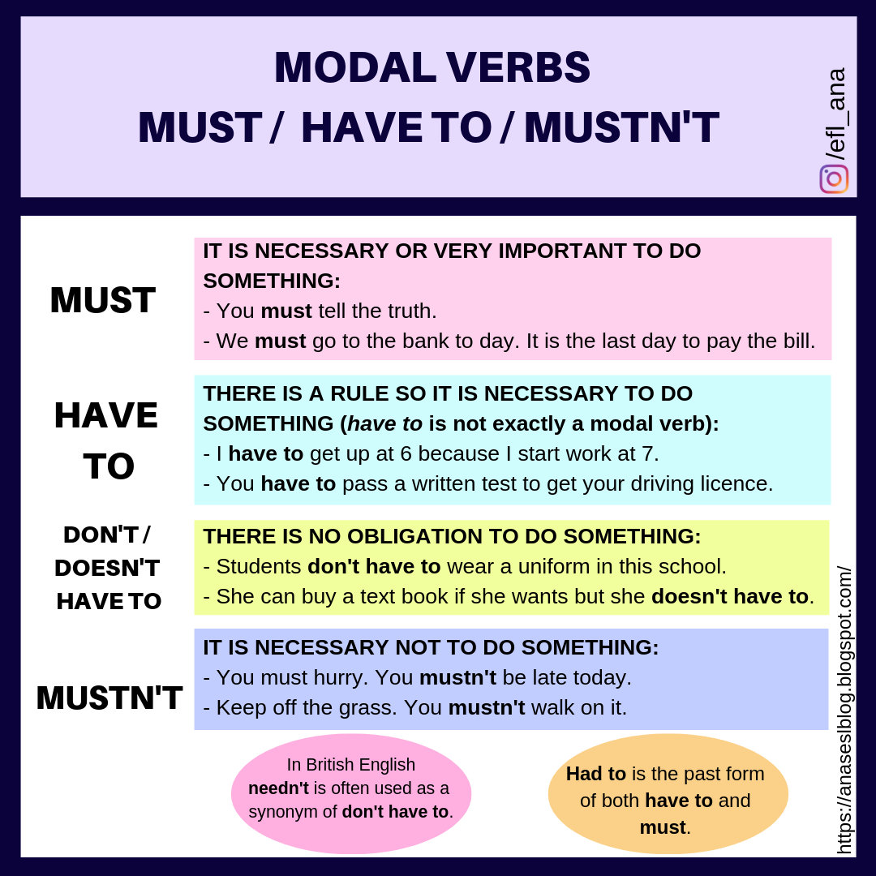
Grammar

Slide 4
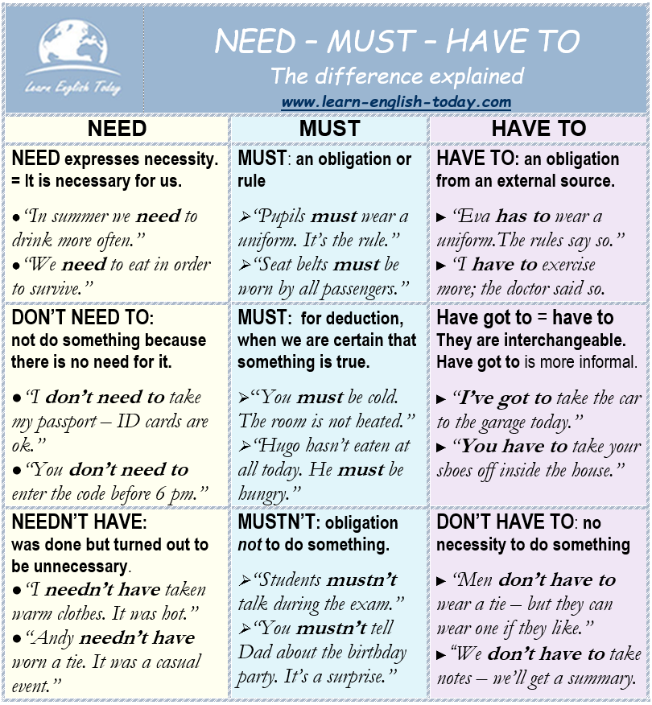
Grammar

Slide 5
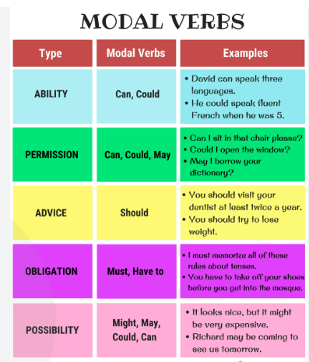
Grammar

Slide 6
listening
Listen to dialogue and circle the correct verbs
Ex 2 p. 34;

Slide 7
Speaking ☺
Audio book;
Review audio book “The house by the sea”
https://www.youtube.com/watch?v=vlvrEpmSoz8

Slide 8
homework
Exercises contains in a folder with this presentation

Slide 9
homework

Slide 10
homework

Slide 11
homework
Exercises contains in a folder with this presentation

